Slide 1
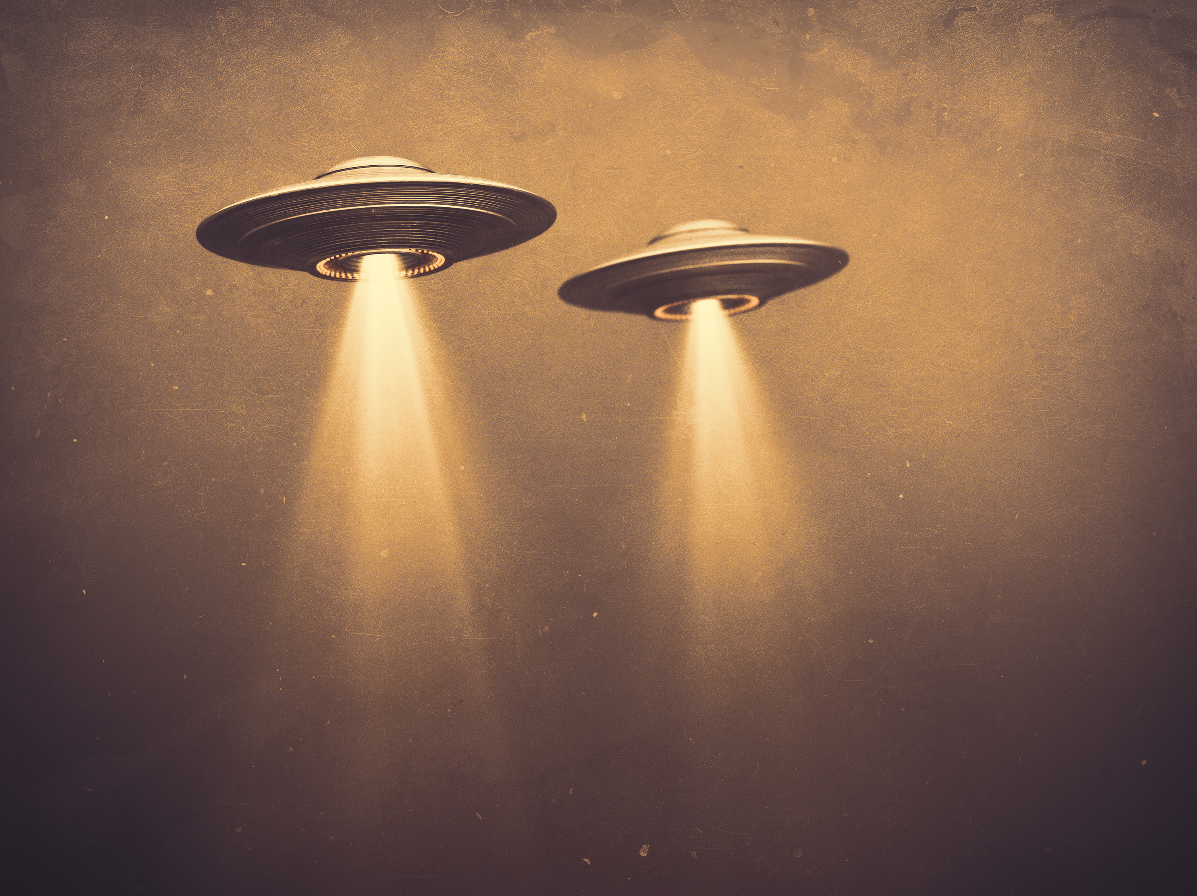
Project 3 by Group 2
UFO Sightings from around the world.

Slide 2





Group 2 members:
Kerry Oostdyk
Misha Mambully
Alison McCondichie
William Berry
Notes:
All

Slide 3
Our Project and Purpose
UFO sightings date back to earliest civilizations.
Crash in Roswell, New Mexico.
UFOs have captured the fascination of human minds.
Our project explores a dataset of UFO sightings reported from around the world.
Aiming to identify patterns and trends from these encounters through a web application.
Interactive platform to explore UFO sighting data.
Notes:
William
UFO sightings date back to earliest civilizations. Accounts from ancient Egypt, the Roman Empire, to ancient India, and Pre-Columbian cultures in the Americas.
Perhaps you have heard of the crash in Roswell, New Mexico in 1947 in which a spacecraft and alien bodies were recovered by the United States Army Air Force.
UFOs have captured the fascination of human minds from time immemorial. As a group, we too felt intrigued when we came across this dataset on the Kaggle website. We thought this could be a good opportunity for us to explore the UFO sightings through data science and visualizations.
Our project explores a dataset of UFO sightings reported from around the world. We are aiming to identify patterns and trends from these encounters through a web application. We are using SQLite as the database, Flask for the back-end, JavaScript with Plotly for data visualization, and we wanted to provide an interactive platform to explore UFO sighting data.

Slide 4
Data & Data Cleaning
Kaggle dataset
Lots of data
Eliminated null values
Deleted unnecessary columns
Changed datetime
Notes:
Misha:
Overall, we had a pretty clean dataset from Kaggle. It contained a lot of data (more than 80,000 rows).
All we did was eliminate some rows that included null values.
We deleted columns we didn't use and changed the datetime to the correct data type.

Slide 5
Research Questions
Are there any trends in reported UFO sightings over time?
What areas report the Most sightings?
Do UFO sightings change in terms of time of day and duration?
Notes:
Misha:

Slide 6
LIVE DEMO
https://kerryoostdyk.pythonanywhere.com/
Home page
Dashboard
Key Questions
Map
Notes:
Kerry

Slide 7
Live DEMO: Are there any trends in reported UFO sightings over time?
The data shows a spike of UFO sightings after the year 2000. This increase could be because of several factors. The widespread use of phones with cameras and especially with smartphones it became easier for people to capture and report the sightings. Also, the development of online reporting platforms may have encouraged individuals to make reports of these sightings. Let's take a look at the bar graph that illustrates this trend.
Notes:
Misha

Slide 8
Live Demo: What areas report the Most sightings?
We see that the United States reports the highest number of UFO sightings. This could be due to a number of reasons. There is a lot of fascination among the people because of the sci-fi movies, television shows, and a wider media coverage. The US military also conducts a lot of test flights. These military activities could be mistaken by the public for UFOs. The US has also established a lot of platforms for the reporting of UFOs. This too could be contributing to an increased number of UFO sighting documentation. Let's explore this various visualization.
Notes:
Misha:

Slide 9
Live Demo: Do UFO sightings change in terms of time of day and duration?
To answer this question, we plotted a bubble chart. When looking at our overall data, there seems to be no correlation between the duration of the sightings and time of day. The duration varies greatly with the time of day. You will notice however, that duration length does increase as time goes on. This is shown in the figure on the following page.
Notes:
Kerry: time of day

Slide 10
Live Demo: MAP
What trends are indicated by our map?
The heat map significantly shows a higher concentration of reported sightings in the US. If we take a closer look, we can see that the coasts of the US have an especially high density of sightings.
The marker clusters help us to zero-in on specific regions where sightings were reported. Some areas are represented with more than one marker, suggesting the sighting was reported by multiple people.
Notes:
Alison
Our map represents density of sightings in two ways, heat map and marker clusters. The heat map significantly shows a higher concentration of data coming from the US. While the marker clusters help us to zero-in on specific regions where sightings were reported.
- the coasts of the Us have a higher density of sightings (as seen from the heat map). is this because those areas are more populated? or would there be another reason for UFO sightings? could it be because the areas are related to geography? could it be because these areas are closer to airports or military bases?
- clusters of sightings in certain areas. Some sightings on our map are populated with 3 markers, because they were reported by multiple people, either individually or in a group. in less populated regions of the world you can see that there is only one marker to correspond with one reported sighting.

Slide 11
Data Limitations and Bias
The data only goes up to 2014.
There is no standardized method of collecting the data or verifying the data.
The US is clearly reporting more sightings.
The data is only on reported sightings instead of observed sightings.
Notes:
Kerry

Slide 12
Conclusions, Call to Action, Future Work
Conclusions:
The US has the greatest number of sightings.
The coasts have a larger concentration of sightings.
No seasonality, no time-of-day factors.
Present day has longer observations and more common observations.
Future Work:
Why does America have the most observations?
Why do observations get more common closer to present day?
More current data is needed.
Notes:
William
Conclusions:
Future work: Future research needs to be completed to discover why the USA has so many more sightings than all other countries. Could it be that Aliens have an obsession with America or another scenario? We also need to find more research on why duration increases as you get closer to the present day. In addition, we see that there is a lack of verification for these sightings. Possible hoaxes? Misidentifications?

